Slide 1
Life Long Family Faith
January 2021
Seven Sorrows and Joys of Saint Joseph

Slide 2
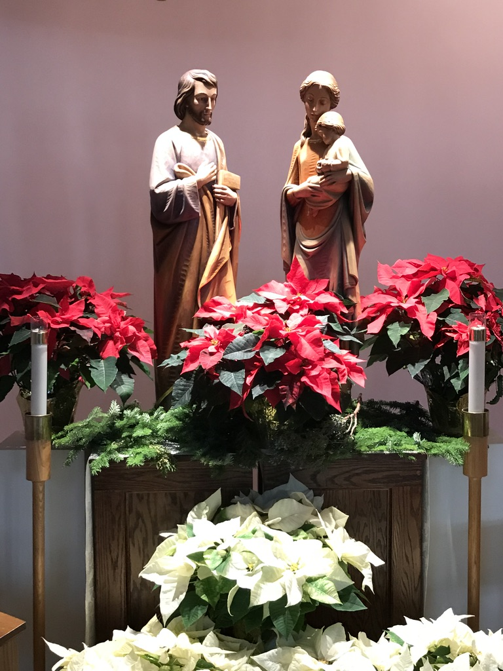
Year of Saint Joseph
With the Apostolic Letter “Patris corde” (“With a Father’s Heart”), Pope Francis recalls the 150th anniversary of the declaration of Saint Joseph as Patron of the Universal Church. To mark the occasion, the Holy Father has proclaimed a “Year of Saint Joseph” from today, 8 December 2020, to 8 December 2021.

Slide 3
Opening Prayer
Glorious Saint Joseph, first man to love Mary and hold Jesus in your arms, accept the prayers we now offer to honor the almighty God and to ask his blessing upon us. We pray that every family will be spiritual and physically protected and guided to fulfill wisely and with love the vocations God has given us. Bless our community of faith; bless God’s family of faith in the Church throughout the world; bless the good works we do to be faithful followers of your foster son, Jesus. We pray especially that God will grant us the favor we ask, or if it is his will, one that He knows is better for us.

Slide 4
Saint Joseph, because of his unique relationship to Jesus and Mary, is among heaven’s most powerful protectors and intercessors.
According to the Catholic Encyclopedia, the Apocryphal Date for Joseph's birth is 90 BC in Bethlehem and the Apocryphal Date of his death is July 20, AD 18 in Nazareth.
Joseph is the patron saint of the dying because, assuming he died before Jesus' public life, he died with Jesus and Mary close to him, the way we all would like to leave this earth.
Joseph is also patron saint of the Universal Church, families, fathers, expectant mothers (pregnant women), travelers, immigrants, house sellers and buyers, craftsmen, engineers, and working people in general.

Slide 5
The Two Feast Days
We celebrate two feast days for Joseph:
March 19 for Joseph the Husband of Mary and May 1 for Joseph the Worker.
March 19 has been the most commonly celebrated feast day for Joseph, and it wasn't until 1955 that Pope Pius XII established the Feast of "St. Joseph the Worker" to be celebrated on May 1.
This is also May Day (International Workers' Day) and believed to reflect Joseph's status as the patron of workers.
Joseph is among a select few saints with more than one feast day, along with Mary, the Mother of God and Saint John the Baptist who follow after the Lord Himself

Slide 6
The Chaste Heart of St. Joseph
St. Joseph is known as “the just man” and, as such, was a man of singular virtue. This strength of character, this reign of virtue, extended to all aspects of his life and his person—including his heart. His whole being was oriented to his God. His love was properly ordered, his affections purified.
Unlike St. Joseph, we tend to struggle, and oftentimes fail, with matters of the heart. Our culture certainly does not hold the virtue of chastity in high esteem. Therefore, it can seem incredible to us that a man like Joseph was able to rise to the lofty challenge presented to him: to be the “chaste guardian of the Virgin” (and of all virgins) and the foster-father of the Son of God. Such a task requires both remarkable human virtue and unexcelled amounts of God’s grace. St. Joseph had both.

Slide 7
The tradition with regard to the age of St. Joseph varies (the Eastern Church holds that he was an old man, while the West concedes that he may have been much younger), but at the heart of the issue is the fact that it was Joseph’s virtue—not merely old age, lack or virility, or lethargic passions—that safeguarded the perpetual virginity of the Mother of God, and allowed him to guide and protect Mary and Jesus with such strength of pure love.
This should be a great consolation to us who still wander in this vale of tears, striving for holiness. St. Joseph was a great man with a “most chaste heart” but whose love was certainly not cold. For this reason, the Diocese of Charlotte’s logo for the Year of St. Joseph depicts his Most Chaste Heart inflamed with love and adorned with the white lily of purity. The heart of St. Joseph should give us great hope that purity of heart lies within our reach, thanks to the grace of God and the intercession of Joseph-most-chaste!

Slide 8
JOSEPH’S SEVEN SORROWS | JOSEPH’S SEVEN JOYS
1. The doubt of St. Joseph (Matt. 1:19) | 1. The message of the Angel (Matt. 1:20)
2. The poverty of Jesus’ birth (Luke 2:7) | 2. The birth of the Savior (Luke 2:10-11)
3. The Circumcision (Luke 2:21) | 3. The Holy Name of Jesus (Matt. 1:25)
4. The prophecy of Simeon (Luke 2:34) | 4. The effects of the Redemption (Luke 2:38)
5. The flight into Egypt (Matt. 2:14) | 5. The overthrow of the idols of Egypt (Is. 19:1)
6. The return from Egypt (Matt. 2:22) | 6. Life with Jesus and Mary at Nazareth (Luke 2:39)
7. The loss of the Child Jesus (Luke 2:45) | 7. The finding of the Child Jesus in the Temple (Luke 2:46)

Slide 9
First Sorrow & Joy
Leader: Chaste lover of Mary, how overwhelmed you were when you thought that you would have to end your betrothal to Mary. But when the Angel of God came to you in a dream, you were filled with awe to realize that Mary would be your wife, and you would be the guardian of the Messiah.
People: Help us, Saint Joseph, help our families and all our loved ones to overcome all sadness of heart and develop an absolute trust in God’s goodness.
Leader: Glory to the Father, and to the Son and to the Holy Spirit
People: As it was in the beginning is now and will be forever. Amen.

Slide 10
Second Sorrow & Joy- the Nativity of Jesus
Leader: Faithful guardian of Jesus and Mary, in your you could only provide a stable for the birth of the holy child. And then, what wonder it was taken when the shepherds came to tell of the choir of angel, and wise men came to adore the King of Kings.
People: Through your example and prayers, help us, Saint Joseph to not want worldly possession but to embrace your adopted son with absolute love and respect.
Leader: Glory to the Father, and to the Son and to the Holy Spirit
People: As it was in the beginning is now and will be forever. Amen.

Slide 11
Third Sorrow & Joy The Presentation and the Naming of Jesus
Leader: Tender–hearted Joseph, you too felt pain when the blood of Jesus was first shed at his circumcision. Yet how proud you were to be the one privileged to give the name “Jesus”, “Savior”, to the very Son of God.
People: Pray for us, Saint Joseph, that the Sacred Blood of Christ. Poured out for our salvation, may guard our families so that the divine name of Jesus may be written in our hearts forever.
Leader: Glory to the Father, and to the Son and to the Holy Spirit
People: As it was in the beginning is now and will be forever. Amen.

Slide 12
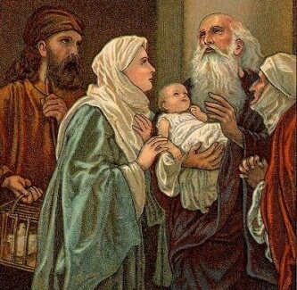
Fourth Sorrow & Joy – The Prophecy of Simeon
Leader: Joseph, loving husband, how bewildered you were when Simeon spoke the words of warning that the hearts of Jesus and Mary would be pierced with sorrows. Yet his prediction that this would lead to the salvation of innumerable souls filled you with consolation.
People: Help us, Saint Joseph, to see with eyes that even the sorrows and pains we endure and those we deeply love can become the pathway to salvation and eternal life.
Leader: Glory to the Father, and to the Son and to the Holy Spirit
People: As it was in the beginning is now and will be forever. Amen.

Slide 13
Fifth Sorrow & Joy – The Flight to Egypt
Leader: Courageous protector of the Holy Family, how terrified you were when you had to make the sudden flight with Jesus and Mary to escape the treachery of king Herod and the cruelty of his soldiers. But when you reached Egypt, what satisfaction you had to know that the Savior of the world had come to replace the pagan idols.
People: Teach us by your example, Saint Joseph, to keep for from the false idols of earthly attractions, so that, like you, we may be entirely devoted to the service of Jesus and Mary.
Leader: Glory to the Father, and to the Son and to the Holy Spirit
People: As it was in the beginning is now and will be forever. Amen.

Slide 14
Sixth Sorrow & Joy – Life in Nazareth
Leader: Ever-obedient Joseph, you trustingly returned to Nazareth at God’s command in spite of fear that King Herod’s son might still be a threat to Jesus’ life. Then what fatherly pride you had in seeing Jesus grow in wisdom and grace before God and men under your care.
People: Show us, Saint Joseph, how to be free from all useless fear and worry so that we may enjoy the peace of a tranquil conscience, living safely with Jesus and Mary in our heart.
Leader: Glory to the Father, and to the Son and to the Holy Spirit
People: As it was in the beginning is now and will be forever. Amen.

Slide 15
Seventh Sorrow & Joy – Losing and Finding Jesus in the Temple
Leader: Dependable father and husband, how frantic you and Mary were when, though no fault of yours, you searched for three days to find Jesus. What incredible relief was yours when you found him safe in the temple of God.
People: Help us, Saint Joseph, never to lose Jesus through the fault of our own sins. But if we should lose him, lead us back with unwearied sorrow until we find him again so that we, like you may finally pass from this life, dying safely in the arms of Jesus and Mary.
Leader: Glory to the Father, and to the Son and to the Holy Spirit
People: As it was in the beginning is now and will be forever. Amen.
Leader: Jesus himself was about thirty years old being, as was supposed, the son of Joseph.

Slide 16
Let us pray together:
To you, O blessed Joseph we have recourse in our afflictions, and after having implored the help of your thrice holy spouse, we now with hearts filled with confidence earnestly beg you also to take us under your protection. By that charity where with you were united to the immaculate virgin Mother of God, and by that fatherly love with which you did cherish the child Jesus, we beseech you and we humble pray that you will look down with gracious eye upon that inheritance which Jesus Christ purchased by his blood and will succor us in our needs by your power and strength.
Defend, O most watchful guardian of the Holy family the chosen offspring of Jesus Christ. Keep from us, O most valiant defender, in this conflict. And even as of old you did rescue the child Jesus from the peril of his life. So now defends God’s holy Church from the snare of the enemy and from all adversity. Shield us ever under your example and strengthened by your help we may live a holy life , die a happy death and attain everlasting bliss in heaven.
Amen

