Slide 1
November 2020
Family Faith

Slide 2
Jesus told his disciples this parable: “A man going on a journey called in his servants and entrusted his possessions to them.
To one he gave five talents; to another, two; to a third, one– to each according to his ability. Then he went away. Immediately
the one who received five talents went and traded with them, and made another five.
Likewise, the one who received two made another two.
But the man who received one went off and dug a hole in the ground and buried his master's money.
After a long time the master of those servants came back and settled accounts with them.
The one who had received five talents came forward bringing the additional five. He said, 'Master, you gave me five talents. See, I have made five more.'
His master said to him, 'Well done, my good and faithful servant. Since you were faithful in small matters, I will give you great responsibilities. Come, share your master's joy.'
(Then) the one who had received two talents also came forward and said, 'Master, you gave me two talents. See, I have made two more.'
His master said to him, 'Well done, my good and faithful servant. Since you were faithful in small matters, I will give you great responsibilities. Come, share your master's joy.'
Then the one who had received the one talent came forward and said, 'Master, I knew you were a demanding person, harvesting where you did not plant and gathering where you did not scatter;
so out of fear I went off and buried your talent in the ground. Here it is back.'
His master said to him in reply, 'You wicked, lazy servant! So you knew that I harvest where I did not plant and gather where I did not scatter?
Should you not then have put my money in the bank so that I could have got it back with interest on my return?
Now then! Take the talent from him and give it to the one with ten.
For to everyone who has, more will be given and he will grow rich; but from the one who has not, even what he has will be taken away.
And throw this useless servant into the darkness outside, where there will be wailing and grinding of teeth.'”

Slide 3
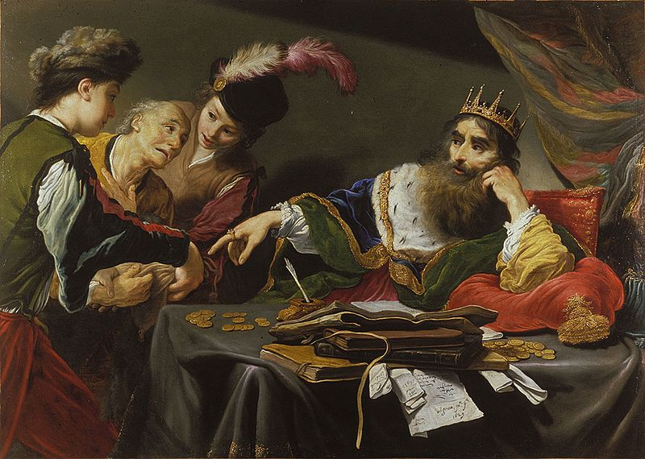
This weekend’s parable suggests 3 questions:
1. Who is the master?
We know he knows his servants
  With an intimate knowledge of their personal abilities right down to their most minute differences
  He entrusts sizeable sums to them, even though they are servants

Slide 4
The master goes away for a long time
leaves them with his talents
  In doing so they know have means to buy their way out of his servitude
  The absence of the master gives them the time to run away
  The master is not out to multiply his fortune (otherwise he would have given the talents to the first servant who could have made the most back)
  We can also conclude that the master does not need to go away for the parable to make sense.

Slide 5
The wicked lazy servant
Reveals deep seated pride
So much so that he did not even see his fellow servants good works, nor ask for help support and guidance, perhaps they even offered it
The gifts given and the abilities of those around him eclipse the significance of what was offered to him. This is what Judas did.

Slide 6
The 3rd servant
One who claims fear prevents him from even investing his/her talent
The one who does not trust the Master

Slide 7
The Servant faithful in small matters
Means using the graces of life in Christ to deepen our relationship with the master

Slide 8
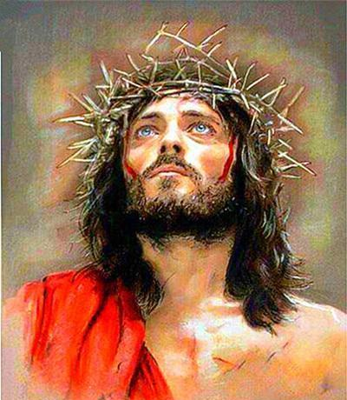
Who is the master?
Matthew is not using a word to describe finance, rather he uses the same Greek word
When describing Jesus handing Himself over to crucifixion
This verb “handing over” describing what the master does when he gives the talents – entrusts his possessions to his servants – is what Jesus, the Divine Son does, trusting in the Father’s will

Slide 9
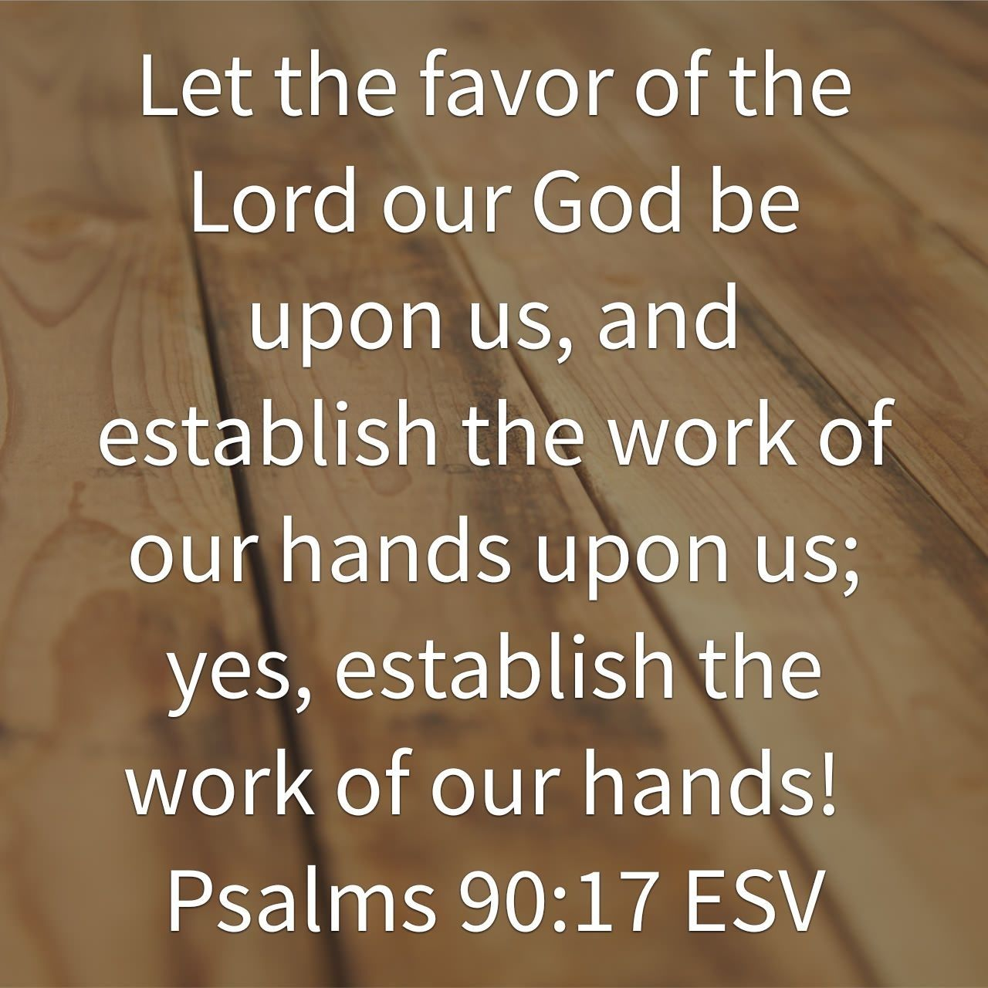
What is the master teaching or doing?
By leaving them alone (unsupervised), he is offering them the means to be transformed.
The master does not want them to make more money, rather he wants them to become something/someone more, united with him and with the gifts he has given them
We see this when he returns – he does not take what has grown through grace and the work of their hands, he doubles down
  This is how the servants become co-heirs – literally his sons
  The master joy consists in seeing his servants become sons
  This is the fruit of divine grace teaching divine trust

Slide 10
Then the parable is really about trust and grace:
Divine Trust.
The "trust" that Jesus asks for, however, is certainly not a passive thing. It is an attitude of total surrender to God that is, perhaps, best understood as an "entrustment" of our whole lives to Him. This involves allowing Him to "take charge" and direct every aspect of our lives, more and more, for our good and for His glory. And this involves surrendering to Him our stubborn self-will and all our actions.
Some people like to quote Romans 8:20,
"All things work together for good." But they leave out the next line: "... for those that love God"!

Slide 11
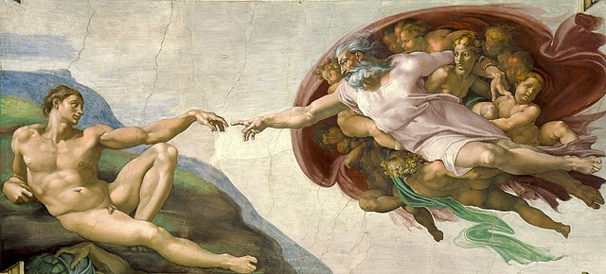
Divine grace is a theological term present in many religions. It has been defined as the divine influence which operates in humans to regenerate and sanctify, to inspire virtuous impulses, and to impart strength to endure trial and resist temptation; and as an individual virtue or excellence of divine origin.

Slide 12
The Master is God the Father - the Talents are Jesus Himself – the Father’s most precious “possession”
It is easy to confuse the talents as – skills, gifts or other capacities.
But we must not confuse the master’s talents with the servant’s abilities – those natural capabilities unique to every servant.
The talents are beyond that:
They are the graces God supplies to our abilities in order to actualize, fulfill and perfect them.
The talents are not natural rather super-natural.
This is how grace perfects nature.

Slide 13
This parable is not about using our particular talents for the glory of god.
The talents belong to the master, not the servants.
The stewardship of the talents transforms the servants from slavery to sonship.

Slide 14
Receive the Father’ Gift – His Son
This prepares us to accept the Father’s Invitation to become perfect – be perfected – by investing to the full – the sacred deposit of the son is our lives.
The treasure the Father gives in His Son awakens us to real abilities that we never knew we had.

Slide 15
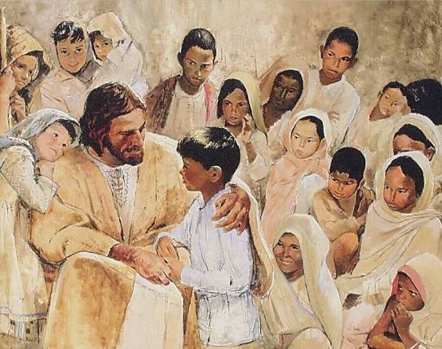
The master offers us, his servants, through the investment of his son:
Sonship – Discipleship – the process of justification
The master’s investment elevates us to make us like himself.
If we cannot understand this parable – we cannot understand the mystery of the Cross.

