Slide 1
Family Faith
October 2021 The Month of the Rosary

Slide 2
Rosary and the Saints for October
The traditional story of the rosary was that Mary herself appeared to Saint Dominic in the twelfth century. At that time, tradition says she gave him the rosary and promised Dominic that if he spread devotion to the rosary, his religious order would flourish.
It is quite true that Dominic was quite devoted to the Blessed Mother.
Originally the rosary had 150 beads, the same number of psalms in the Bible.

Slide 3
"Moreover, we may well believe that the Queen of Heaven herself has granted an especial efficacy to this mode of supplication, for it was by her command and counsel that the devotion was begun and spread abroad by the holy Patriarch Dominic." - Pope Leo XIII, (Octobri Mense Encyclical on the Rosary, 1891) -
In the twelfth century, religious orders recited together the 150 Psalms as a way to mark the hours of the day and the days of the week. Those people who didn’t know how to read wanted to share in this practice, so praying on a string of 150 beads or knots began as a parallel to praying the psalms. It was a way that the illiterate could remember the Lord and his mother throughout the day.
The “Divine Office”; the official prayer of the church; is the recitation of the psalms over a four week period, and is still prayed today. This first rosary was prayed as we do today, a person would pass their fingers over each bead and say a prayer, usually the “Our Father”.

Slide 4
Mysteries
In the fifteenth century, a Carthusian monk divided the rosary into fifteen brackets (or decades) and a Dominican assigned mysteries to each of the decades. These mysteries were events in the life of Jesus as written in the gospels. By meditating on these events even the illiterate could know the stories in the Bible.
These decades were the same as ours except for the last two Glorious mysteries. In those two, the Coronation and the Assumption together made up the fourteenth decade and the fifteenth decade was the Last Judgment.
On October 16, 2002, Pope John Paul II, declared that the following year would be the “Year of the Rosary”. For the first time in centuries a change was made in the rosary.
The Pope added and defined 5 new mysteries that concerned events in the public life of Jesus. These new mysteries were called the “Luminous Mysteries” or “Mysteries of Light”
Excerpts provided by the Diocesan Shrine of Pope, Saint John Paull II

Slide 5
Decades
Today’s complete rosary is now made up of twenty decades of the Hail Mary, separated by an Our Father and a Glory Be and sometimes the Fatima prayer.
Evidence again that the rosary is a living prayer that grows with the church. We usually break the rosary into four sets. The four sets are The Joyful Mysteries, The Sorrowful Mysteries, The Glorious Mysteries, and the Luminous Mysteries.
One set is prayed on a rosary that has five decades. Each set is prayed on designated days of the week. There are variations however, and in some countries the rosary may even have different mysteries. Despite all the additions and changes, the important core of the rosary has always remained the same.

Slide 6
World Missionary Rosary
In February of 1951, Archbishop Fulton J. Sheen (national director of the Society for the Propagation of the Faith from 1950 to 1966), in a radio address (The Catholic Hour), inaugurated a World Mission Rosary. “We must pray, and not for ourselves, but for the world. To this end, I have designed the World Mission Rosary. Each of the five decades is of a different color to represent the continents.”
Praying this Rosary, Archbishop Sheen said, would “aid the Holy Father and His Society for the Propagation of the Faith by supplying Him with practical support, as well as prayers, for the poor mission territories of the world.”

Slide 7
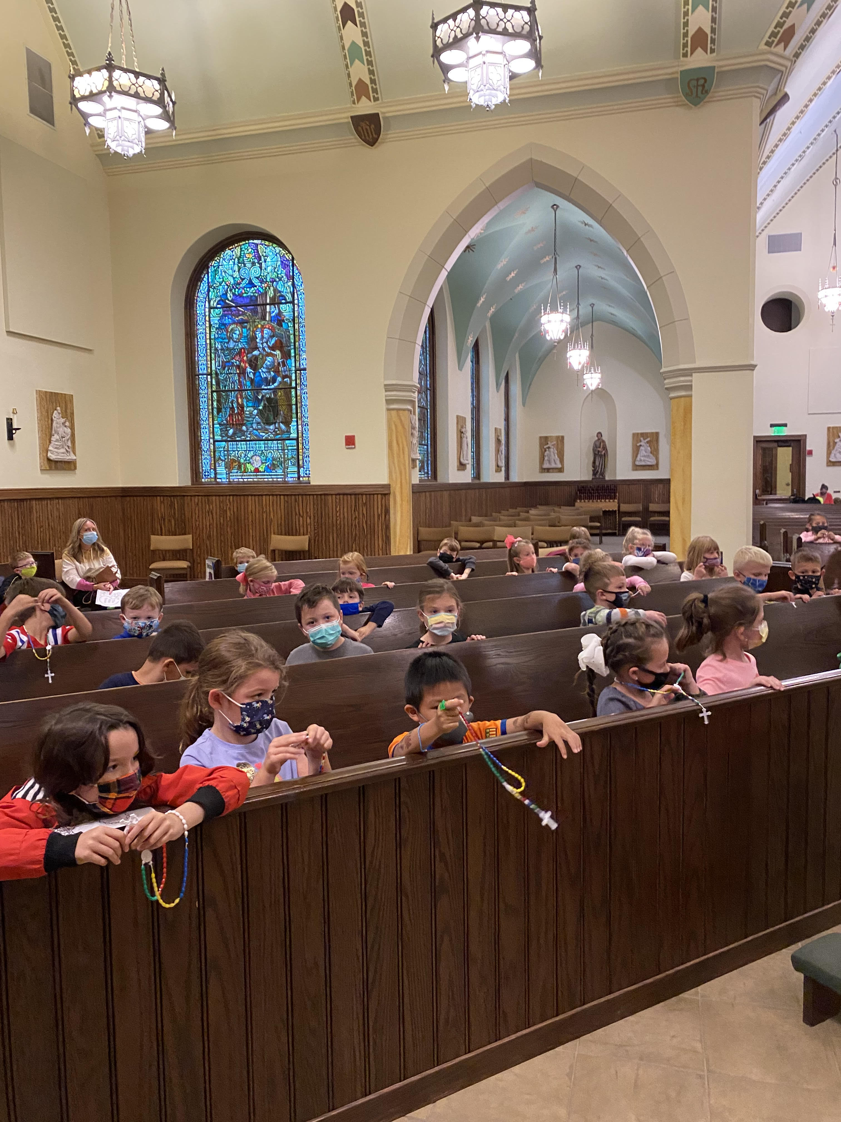

Slide 8
Saints of October
Feast of the Guardian Angels Oct 2nd
St. Theresa of the Child Jesus Oct 1st
St. Mother Theodore Guerin Oct 3rd
St. Francis of Assisi Oct 4th
Our Lady of the Rosary Oct 7th
Blessed Carlo Acutis Oct 12th
St. Teresa of Avila Oct 15t
St. Luke Oct 18th
World Mission Sunday Oct 24th
Sts. Simon & Jude

Slide 9
Saint Thérèse prayer to her guardian angel The "Little Flower" wanted to give thanks to her Guardian Angel, and ask for much needed help. St. Thérèse of Lisieux had a pure and child-like soul. She trusted in God throughout all the trials in her life. She also recognized the guidance and protection of her Guardian Angel and composed a poem in 1897 to give thanks, but also to ask for help. Thérèse was ill and would die seven months after she wrote this poem.
O glorious guardian of my frame! In heaven’s high courts thou shinest bright, As some most pure and holy flame, Before the Lord of endless light. Yet for my sake thou com’st to earth, To be my brother, Angel dear: My friend and keeper from my birth By day and night to me most near.
Knowing how weak a child am I, By thy strong hand thou guidest me; The stones that in my pathway lie, I see thee move them carefully. Ever thy heavenly tones invite My soul to look to God alone; And ever grows thy face more bright, When I more meek and kind have grown.
O thou who speedest through all space More swiftly than the lightnings fly! Go very often, in my place, To those I love most tenderly.
With thy soft touch, oh! dry their tears; Tell them the cross is sweet to bear; Speak my name softly in their ears, And Jesu’s name, supremely fair.
Through all my life, though brief it be, I fain would succor souls from sin. Dear Angel, sent from heaven to me, Kindle thy zeal my heart within! Naught but my holy poverty, And daily cross to give have I; O join them to thine ecstasy, And offer them to God on high.
Thine are heaven’s glory and delight, The riches of the King of kings; The Host in our ciboriums bright Is mine, and all the wealth pain brings. So with the Cross, and with the Host, And with thine aid, dear Angel Friend, I wait in peace, on time’s dark coast, Heaven’s happiness that knows no end.

Slide 10
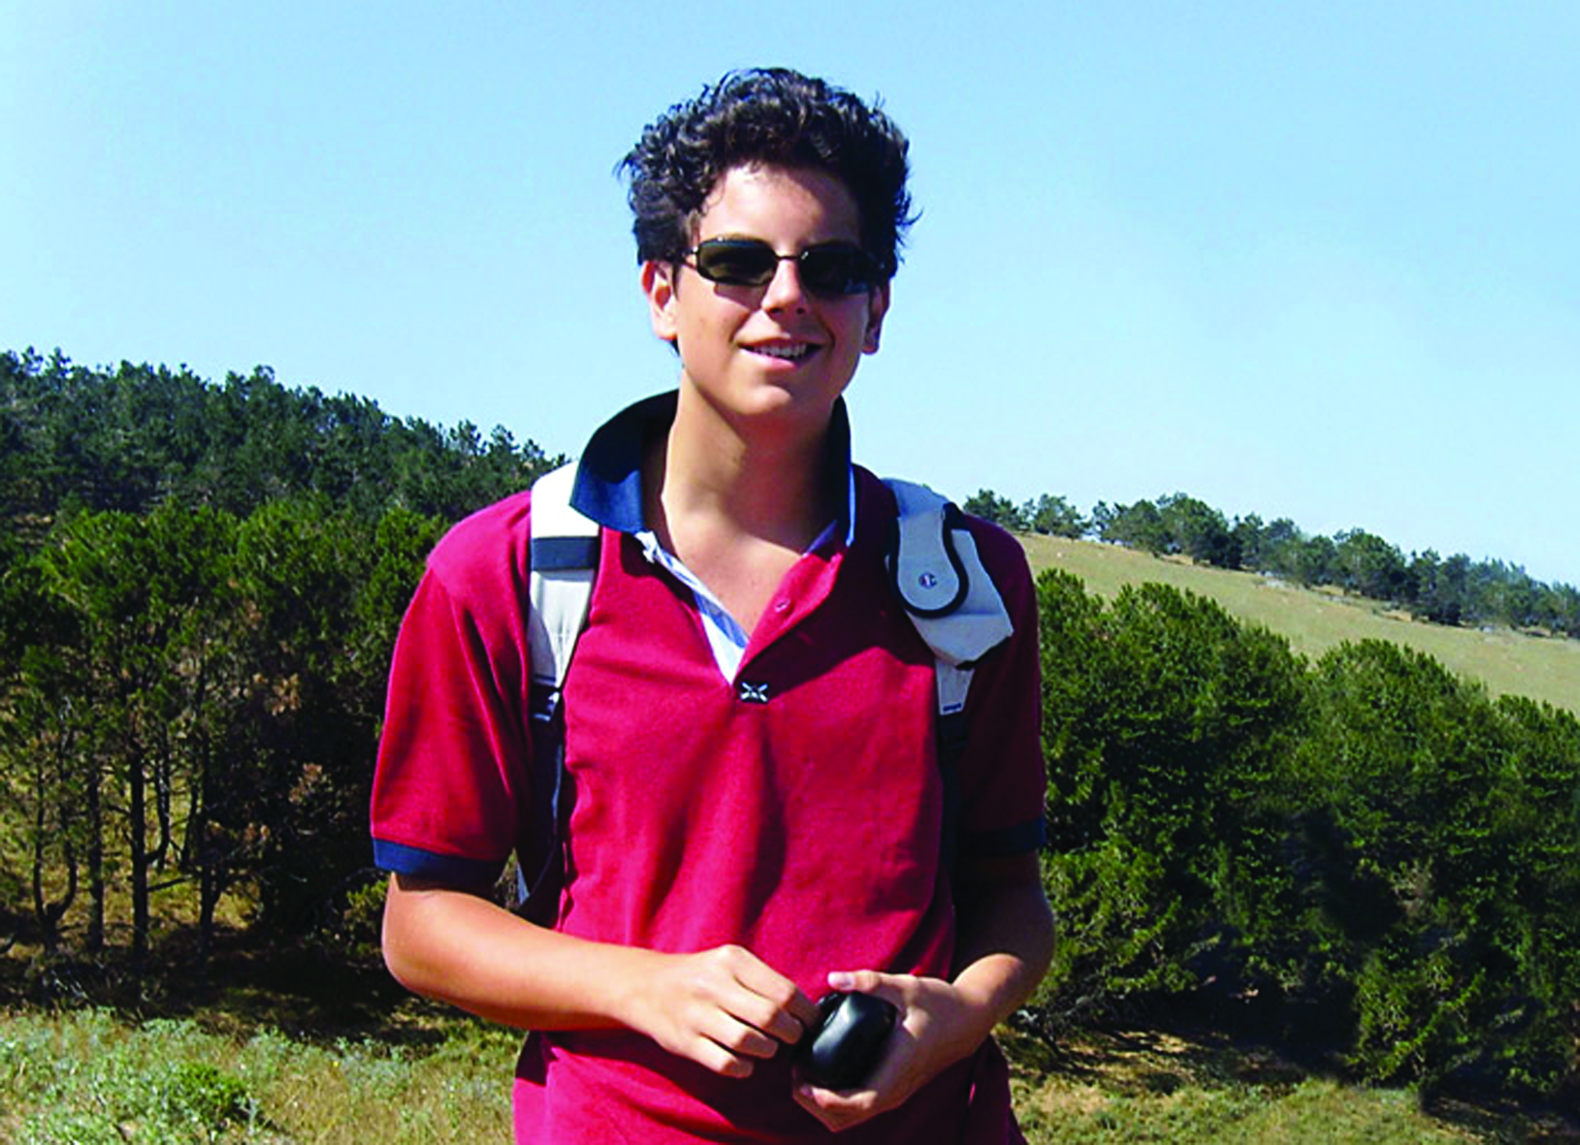
Blessed Carlo
He hiked, played soccer, went to daily Mass and was filled with the love of God.

Slide 11
His Mother reflects
Pope Francis has approved a miracle attributed to Carlo Acutis, paving the way for his beatification, which took place on October 10 in Assisi, last year, where he is buried.
Carlo was in many ways an ordinary young man. He had a PlayStation. He made awkward videos with his friends. His favorite cartoon was “Pokémon.” But now, he becomes “Blessed Carlo Acutis.”
It was announced in February 22, 2020, that Pope Francis had approved a miracle attributed to Acutis, paving the way for his beatification in Assisi, where he is buried.
Acutis’ intercession reportedly helped to heal a Brazilian child suffering from a rare condition of the pancreas in 2013.

Slide 12
Acutis’ mother, Antonia, doesn’t know how Carlo came to love Jesus. He’d been baptized as a baby, but the family didn’t practice the Faith. Perhaps it was their Polish nanny who told Carlo about Jesus.
Regardless of the source, Carlo had a deep love for Jesus even as a preschooler, asking his bemused mother if they could stop in to see Jesus when they walked past churches in their Milan neighborhood — and even insisting on taking flowers to place at the feet of the Blessed Mother.
Antonia wasn’t sure what to do with this piety in her young son, and she wasn’t prepared to answer his many questions. But as he asked, she began to wonder as well. His curiosity eventually prompted her to take theology classes; beyond just being back at Mass, Antonia was diving into her faith, and all because of Carlo. “He was like a little savior for me,” she said in an interview published last year on the website Aleteia.

Slide 13
Fostering a love of the Faith
Carlo’s longing for the Eucharist drove him to ask permission to receive earlier than was customary. At 7, Carlo received his First Communion and never missed Mass again. Not just Sunday Mass, either. Every day of his life, Carlo went to Mass. Every day, he stole a few minutes to pray in silence before the tabernacle.
And while his parents sometimes went with him, Carlo often went alone. When they traveled, Carlo’s first order of business was to find a church and figure out Mass times. Whether or not his parents joined him, Carlo would be there. Every day.
And they traveled quite a bit. Carlo’s deep love of Mary (whom he called “the only woman in my life”) led the family to Marian apparition sites all over Europe. But their pilgrimages became more intentional when Carlo was 11 and got an idea.

Slide 14
Research
Carlo’s longing for the Eucharist drove him to ask permission to receive earlier than was customary. At 7, Carlo received his First Communion and never missed Mass again. Not just Sunday Mass, either. Every day of his life, Carlo went to Mass. Every day, he stole a few minutes to pray in silence before the tabernacle. And while his parents sometimes went with him, Carlo often went alone. When they traveled, Carlo’s first order of business was to find a church and figure out Mass times. Whether or not his parents joined him, Carlo would be there. Every day.
And they traveled quite a bit. Carlo’s deep love of Mary (whom he called “the only woman in my life”) led the family to Marian apparition sites all over Europe. But their pilgrimages became more intentional when Carlo was 11 and got an idea.

Slide 15
Caring for those around him
But Carlo was no computer geek closeted in a back bedroom. For all his technological skill, Carlo was a friendly, outgoing kid. He was so friendly that his family was reluctant to go on walks with him; Carlo knew everybody, it seemed, and couldn’t help but stop to talk to every person he passed. He had a sensitive heart and was always looking out for those who were suffering: classmates whose parents were going through a divorce, kids who were being bullied.
Carlo’s approach was always friendship. And through that friendship, people were always drawn to Jesus. As pure and as pious as he was, nobody felt judged by the young saint. His uncle says that being with Carlo filled your heart. And that joy left people seeking and wondering, as Carlo’s mother had years before. A young Hindu man who worked for Carlo’s family was baptized as a direct result of his friendship with Carlo, while many others returned to the Faith.

Slide 16
Carlo was particularly close to the homeless people in his neighborhood, packing up food most days to take out to his friends on the street. Though his family was wealthy, Carlo had no patience for excess. He saved up his pocket money to buy a sleeping bag for a homeless friend, and when his mother suggested they buy Carlo such “luxuries” as a second pair of shoes, he revolted. Technology, though, wasn’t a luxury. It was an important part of his apostolate, and Carlo had no qualms about using three computers when building his website.

Slide 17
“I can die happy”
How did he have the time in between teaching himself to code, playing soccer, riding his bike around Milan to visit the poor, teaching himself the saxophone, patiently explaining technology to his older relatives and making one movie after another? According to his mother, Carlo didn’t waste time on useless things. He limited himself to an hour a week of video games (because he said, he didn’t want to become a slave to them) and focused the rest of his time on things that were valuable. But that didn’t exclude silly animations or videos of his dogs — Carlo knew that something doesn’t need to be catechetical to be valuable, and he enjoyed leisure all the more because its greatest value was in being fun.
Carlo hungered for heaven. “We have always been awaited in heaven,” he said, and throughout his life his eyes were fixed on eternity. So when, at 15, he went to the hospital with the flu and was diagnosed instead with an acute and untreatable leukemia, Carlo wasn’t upset. He was ready to go home. “I can die happy,” he told his mother, “because I haven’t wasted even a minute on things that aren’t pleasing to God.”
Within three days, Carlo Acutis was dead.

Slide 18
An Ordinary young man – an extraordinary Witness
He was a remarkable young man, but he was an ordinary man. He had no visions. He didn’t levitate when he prayed. He just lived like heaven was real. He was completely himself, video games and computer programming and all, but entirely Christ’s.
On his website, Carlo wrote a list of instructions for becoming holy, encouraging people to go to Mass daily and confession weekly. But his very first rule for becoming holy was this: “You must want it with all your heart.”
This is the legacy of Venerable Carlo Acutis: an ordinary, modern kid who watched cartoons and used the internet and wanted holiness with all his heart. This is why the world loves him. Because he shows us that holiness is possible. For every one of us. Even if you have an Instagram account. Even if you’re a gamer.

Slide 19
Carlo Acutis was born in 1991. That fact alone is a testimony: holiness is possible. For you. Right now. But you have to want it.
Visit his website he created
https://www.carloacutis-en.org/

Slide 20
Catholic Brain
https://www.catholicbrain.com/login

