Slide 1
December Family Faith
Our Lady of Guadalupe & Saint Joseph: helping us understand Christmas, Motherhood and the New Year

Slide 2
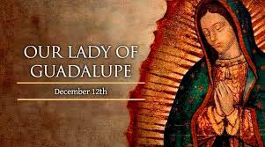
Our Lady of
Guadalupe
A mother to all mothers

Slide 3
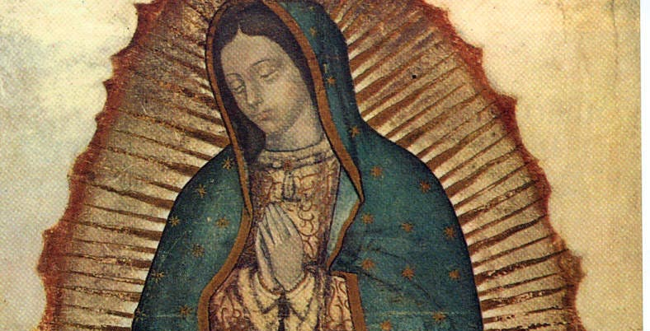

Slide 4
The story of Our Lady of Guadalupe
December 12th is the Feast Day of Our Lady of Guadalupe.
We take a look at the story behind the indigenous peasant who came across the Patron of the Americas, and how he fought for her message to be heard.
By Francesca Merlo
Vatican New.va

Slide 5
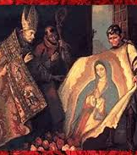
The Virgin of Guadalupe, like the shroud of Turin, appears on a piece of fabric. Both are sacred objects, hundreds of years old, and both depict an image said to be miraculous. The Virgin of Guadalupe was declared Queen of Mexico and is Patron of the Americas.
First apparition
Our Lady of Guadalupe first introduced herself as the Mother of God and the mother of all humanity when she appeared on the hill of Tepeyac in Mexico in 1531. An indigenous peasant, Juan Diego, saw a glowing figure on the hill. After she had identified herself to him, Our Lady asked that Juan build her a shrine in that same spot, in order for her to show and share her love and compassion with all those who believe.
Afterwards, Juan Diego visited Juan de Zumárraga, who was Archbishop of what is now Mexico City. Zumárraga dismissed him in disbelief and asked that the future Saint provide proof of his story and proof of the Lady’s identity.
Juan Diego returned to the hill and encountered Our Lady again. The Virgin told him to climb to the top of the hill and pick some flowers to present to the Archbishop.

Slide 6

Winter Bloom
Although it was winter and nothing should have been in bloom, Juan Diego found an abundance of flowers of a type he had never seen before. The Virgin bundled the flowers into Juan's cloak, known as a tilma. When Juan Diego presented the tilma of exotic flowers to Zumárraga, the flowers fell out and he recognized them as Castilian roses, which are not found in Mexico.
What was even more significant, however, was that the tilma had been miraculously imprinted with a colorful image of the Virgin herself.

Slide 7
Tilma
This actual tilma, preserved since that date and showing the familiar image of the Virgin Mary with her head bowed and hands together in prayer, represents the Virgin of Guadalupe. It remains perhaps the most sacred object in all of Mexico.
The story is best known from a manuscript written in the Aztec’s native language Nahuatl by the scholar Antonio Valeriano. It was written sometime after 1556.
Over 20 million people visit the Basilica of Our Lady of Guadalupe each year, now situated on the very same hill on which she appeared.
In 1990, Pope Saint John Paul II visited Mexico and beatified Juan Diego. 10 years later, in the year 2000, he was declared a Saint.

Slide 8
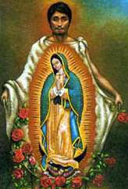
St. Juan Diego

Slide 9
Over the centuries, Our Lady of Guadalupe has not faded out of memory but has grown ever more important for Catholics around the world, especially for Mexicans, for whom she is a treasured symbol of cultural identity. And as Patroness of the Americas, her influence is incalculable on the many generations who have lived in North, South, and Central America since her apparition.
Her image is different from other apparitions and even from most artistic depictions of Our Lady. These differences make Our Lady of Guadalupe a natural and sympathetic intercessor for pregnant women, a companion and guide who can truly walk through the months of pregnancy alongside expectant mothers. These two reasons in particular elucidate why mothers can turn to “La Guadalupana” for prayers and deep understanding.

Slide 10
OUR LADY OF GUADALUPE IS
PREGNANT HERSELF
Our Lady of Guadalupe appears as a pregnant woman, probably very near to giving birth (which makes sense, given that the apparitions took place only a few weeks before Christmas). Her pregnancy is apparent, not only because of her rounded abdomen, but because of the black sash she wears around her waist, which indicates that she is with child.
It’s still rare today to see images of Our Lady during her pregnancy—she is usually shown after giving birth—and it was even less common at that time. Mary’s choice to appear as an expectant mother is an act with great significance for all pregnant women.

Slide 11
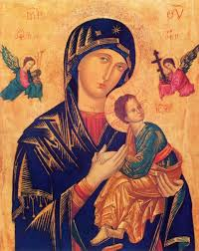
When expectant mothers see an image of Our Lady of Guadalupe, they see someone who is walking in their shoes, quite literally. Pregnancy is replete with aches and pains, especially in the later months. Our Lady of Guadalupe intimately understands what a pregnant woman is going through, both the physical discomfort and the emotional upheaval that often comes with the territory.
Our Lady had to make a long and difficult journey very soon before giving birth. She had to leave her family and hometown to have her baby far away from home. If anyone can sympathize with the concerns and uncertainties plaguing a pregnant woman, especially during this pandemic when so many things seem topsy-turvy, it’s the wise and gentle woman at Tepeyac Hill.
Her response to these difficulties, of course, is an inspiration to us all. She retained her inner peace and trust in God throughout all the hardships she faced. In imitation of her, all Christians, especially pregnant women, can turn to her intercession when we face problems that test our serenity and faith. We can ask her to share that abiding peace with us.

Slide 12
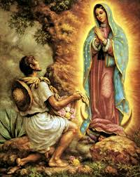
SHE BRINGS A MESSAGE OF
RADICAL CONSOLATION
Listen, put it into your heart, my youngest and dearest son, that the thing that frightens you, the thing that afflicts you, is nothing: Do not let it disturb you … Am I not here, I who am your Mother? Are you not under my shadow and protection? Am I not the source of your joy? Are you not in the hollow of my mantle, in the crossing of my arms? Do you need something more? Let nothing else worry you or disturb you.

Slide 13
Beautiful reflections from
Antoine Mekary | ALETEIA | I.Media
Her message, assuring her beloved child not to be afraid because she is present, is one that is familiar to all mothers. How many times have we spoken similar words ourselves? But to hear them spoken to us, instead of by us—to know how deeply and personally we are loved, not only by Christ but also by His cherished mother—is enough to take one’s breath away.
In pregnancy and motherhood, and indeed in almost all areas of life, it’s almost a guarantee that something won’t go as planned and expected. Through all of this, Our Lady of Guadalupe reassures us, saying, “Don’t be afraid. I’m here.” In troubles and sorrow, in fear and confusion, like anxious children clinging to a sure refuge, we can find comfort in her embrace.

Slide 14
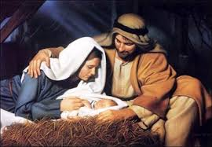
2021 Dedicated to Saint Joseph
Church grants plenary indulgence for year of St. Joseph
The Apostolic Penitentiary issues a Decree granting plenary indulgences for the year of St. Joseph proclaimed by Pope Francis on Tuesday. The special year will last from 8 December 2020 to 8 December 2021.
Church grants plenary indulgence for year of St. Joseph
The Apostolic Penitentiary issues a Decree granting plenary indulgences for the year of St. Joseph proclaimed by Pope Francis on Tuesday. The special year will last from 8 December 2020 to 8 December 2021.

Slide 15
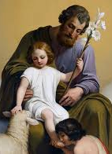
Pope Francis on Tuesday announced a special year dedicated to St. Joseph starting from 8 December 2020 until 8 December 2021, on the occasion of the 150th anniversary of the proclamation of St. Joseph as the Patron of the Universal Church, as well as the Solemnity of the Immaculate Conception of Our Lady.
The Apostolic Penitentiary also issued a decree granting special indulgences for the duration of the special year to celebrate the anniversary and “to perpetuate the entrustment of the whole Church to the powerful patronage of the Custodian of Jesus.”

Slide 16
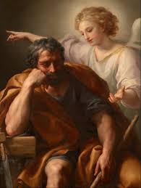
During this period, the faithful will have the opportunity to commit themselves “with prayer and good works, to obtain, with the help of St. Joseph, head of the heavenly Family of Nazareth, comfort and relief from the serious human and social tribulations that besiege the contemporary world today.”

Slide 17
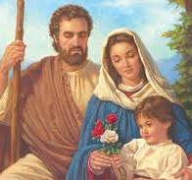
Devotion to St. Joseph
The decree signed by Cardinal Mauro Piacenza, the Major Penitentiary of the Apostolic Penitentiary, and the Regent, Fr. Krzysztof Nykiel, notes that devotion to St. Joseph has grown extensively throughout the history of the Church, “which not only attributes to him high reverence after that of the Mother of God his spouse but has also given him multiple patronages.”
At the same time, the Magisterium of the Church continues to discover “old and new greatness in this treasure which is St. Joseph, like the master in the Gospel of Matthew who brings from his storeroom both the new and the old.”

Slide 18
Conditions for the plenary indulgence
The plenary indulgence is granted to the faithful under the usual conditions (sacramental confession, Eucharistic Communion, and prayer for the Pope’s intentions) to Christians who, with a spirit detached from any sin, participate in the Year of St. Joseph on these occasions and manners indicated by the Apostolic Penitentiary:
The plenary indulgence is granted to those who will meditate for at least 30 minutes on the Lord’s Prayer, or take part in a Spiritual Retreat of at least one day that includes a meditation on St. Joseph. “St. Joseph, an authentic man of faith, invites us”, the decree reads, “to rediscover our filial relationship with the Father, to renew fidelity to prayer, to listen and correspond with profound discernment to God’s will.”

Slide 19
The indulgence can also be obtained by those who, following St. Joseph’s example, will perform a spiritual or corporal work of mercy. St. Joseph “encourages us to rediscover the value of silence, prudence and loyalty in carrying out our duties,” the decree notes.
The recitation of the Holy Rosary in families and among engaged couples is another way of obtaining indulgences, in order that “all Christian families may be stimulated to recreate the same atmosphere of intimate communion, love and prayer that was in the Holy Family.”
Everyone who entrusts their daily activity to the protection of St. Joseph, and every faithful who invokes the intercession of St. Joseph so that those seeking work can find dignifying work can also obtain the plenary indulgence. On 1 May 1955, Pope Pius XII instituted the feast of St. Joseph “with the intent that the dignity of work be recognized by all, and that it inspires social life and laws, based on the fair distribution of rights and duties.”
The plenary indulgence is also granted to the faithful who will recite the Litany to St. Joseph (from the Latin tradition), or the Akathistos to St. Joseph (from the Byzantine tradition), or any other prayer to St. Joseph proper to the other liturgical traditions, for the persecuted Church ad intra and ad extra, and for the relief of all Christians suffering all forms of persecution. Because, the decree notes, “the flight of the Holy Family to Egypt shows us that God is there where man is in danger, where man suffers, where he runs away, where he experiences rejection and abandonment.”

Slide 20
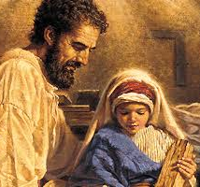
A universal saint
In addition to these, the Apostolic Penitentiary grants a plenary indulgence to the faithful who will recite any legitimately approved prayer or act of piety in honor of St. Joseph, for example, “To you, O blessed Joseph” especially on “19 March, on 1 May, the Feast of the Holy Family of Jesus, Mary and Joseph, on St. Joseph’s Sunday (according to the Byzantine tradition) on the 19th of each month and every Wednesday, a day dedicated to the memory of the saint according to the Latin tradition.”
The decree recalls the universality of St. Joseph’s patronage of the Church, noting that St. Teresa of Ávila recognized him as "a protector for all the circumstances of life". Pope St. John Paul II also said that St. Joseph has “a renewed relevance for the Church of our time, in relation to the new Christian millennium.”

Slide 21
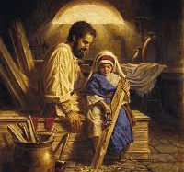
For the sick
Amid the ongoing Covid-19 health crisis, the gift of the plenary indulgence is also extended to the sick, the elderly, the dying and all those who for legitimate reasons are unable to leave their homes.
They too can obtain the plenary indulgences if they are detached from any sin and have the intention of fulfilling, as soon as possible, the three usual conditions and recite an act of piety in honor of St. Joseph, offering to God the pains and hardships of their lives.

Slide 22
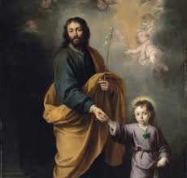
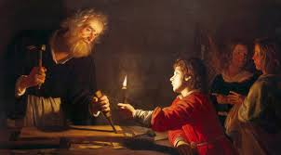

Slide 23
The most important part of devotion to St. Joseph is imitating his example.
While prayers and devotions are important to honor St. Joseph, what is more important is to imitate the life and example of the foster-father of Jesus.
In the 19th-century book Devotion to Saint Joseph, the author explains this concept plainly.
The most excellent devotion towards our holy patrons consists in imitating their virtues. Endeavor each day to practice some of those virtues which shone in St Joseph; for example, conformity to the holy will of God.The book also details a helpful practice that can remind you to imitate St. Joseph.
Father Louis Lalemant, having chosen St Joseph for model of the interior life, practiced each day in his honor the following exercises: two in the morning and two in the evening.

Slide 24
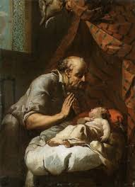
Four ways Joseph Teaches us
LISTEN TO THE HOLY SPIRIT
The first was to raise his mind toward the heart of St. Joseph and consider how docile he had been to the inspirations of the Holy Spirit. Then examining his own heart, he humbled himself for his times of resistance, and animated himself to follow more faithfully the inspirations of grace.
UNITY OF PRAYER AND WORK
The second was to consider with what perfection St. Joseph united the interior life to the occupations of his state in life. Then reflecting on his own life, he examined if there were some defects to correct. Father Lalemant attained by this holy practice to a great union with God and he knew how to preserve it in the midst of occupations which seemed the most distracting.
DEVOTION TO THE VIRGIN MARY
The third was to unite himself spiritually to St. Joseph as spouse of the Mother of God; and considering the admirable lights which the saint had on the virginity and maternity of Mary, he encouraged himself to love this holy patriarch for the love of his holy spouse.
ADORE THE CHRIST CHILD
The fourth was to represent to himself the profound adoration and the paternal services which St. Joseph had rendered to the Child Jesus: he asked to be permitted to join with him in adoring, loving, and serving this Divine Infant with the tenderest affection and the profoundest veneration.

Slide 25
Saint Joseph Pray for us!

